Slide 1


TuneMe – Music Recommendation and Search Engine
Notes:
Hello, My name is Zaina Qasim. And for my senior design project, I am working on an application called Tune Me that generates playlists of music based on user defined preferences.

Slide 2
Project Members and Advisor
Member(s)
Zaina Qasim
qasimza@mail.uc.edu
Faculty Advisor
Fred Annexstein
fred.annexstein@uc.edu
Notes:
I am the only member in my team and the faculty advisor for my project is Dr. Fred Annexstein

Slide 3
Project Background and Goals
The most popular music listening, and recommendation apps are Apple Music and Spotify. The former uses listening history and similarity to other users' tastes to recommend music, and the latter analyzes a song's rhythm and structure. Both do not ask users to specify their definition of "similarity" - by artists, years, and/or genres, etc. This project aims to provide better suggestions by doing so.

Slide 4
Intellectual Merits
User Focused Design = Potential for Improving Music Discovery: TuneMe addresses a gap in existing music recommendation systems by allowing users to specify their definition of similarity. This means that the application has the potential to improve music discovery by providing users with more personalized and accurate recommendations.
Data Set with Lyric-Theme Tagging: A webscraper was used to generate a dataset comprising of roughly 20,000 data points with lyric to theme tagging which can be useful in searching for music based on themes. An ML model was also used to predict the themes of other songs that are not tagged yet.

Slide 5

Broader Impacts
Improved Access to Music: By providing more accurate and personalized music recommendations, TuneMe can improve access to music for users who may have otherwise struggled to find new music that they enjoy. This has the potential to enhance people's overall enjoyment of life.
Promoting Cultural Diversity: TuneMe is capable of finding music in languages other than English if the user opts to. T By recommending music in other languages, TuneMe can expose users to new cultures and promote cross-cultural understanding.

Slide 6

Design Specifications
System overview
Design Diagrams

Slide 7
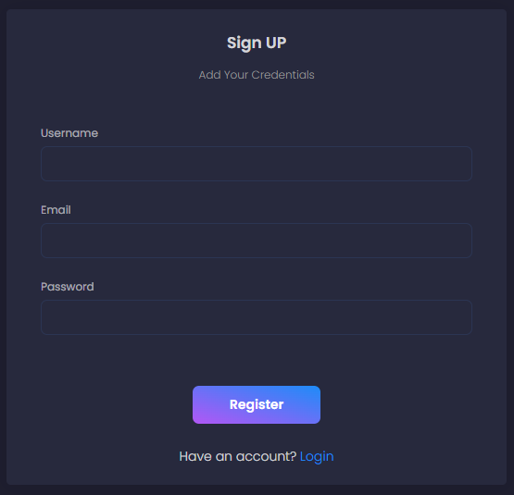
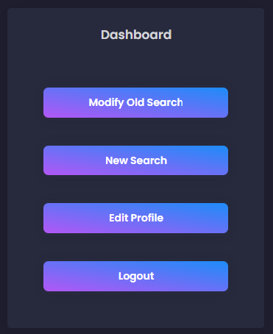
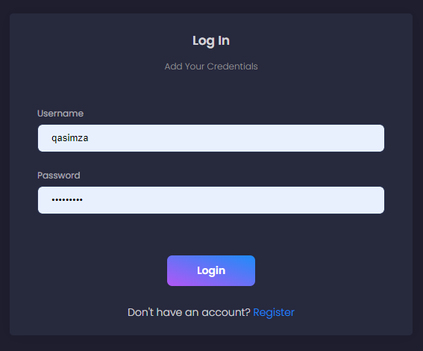
System Overview
Intended Audience/User:
Anyone who wants to find new music.
Key features and functionality (Signup, Login, Dashboard):
Simple dashboard accessible after creating an account and logging in.
Dashboard links to new search page, old searches and a page to edit profile.

Slide 8
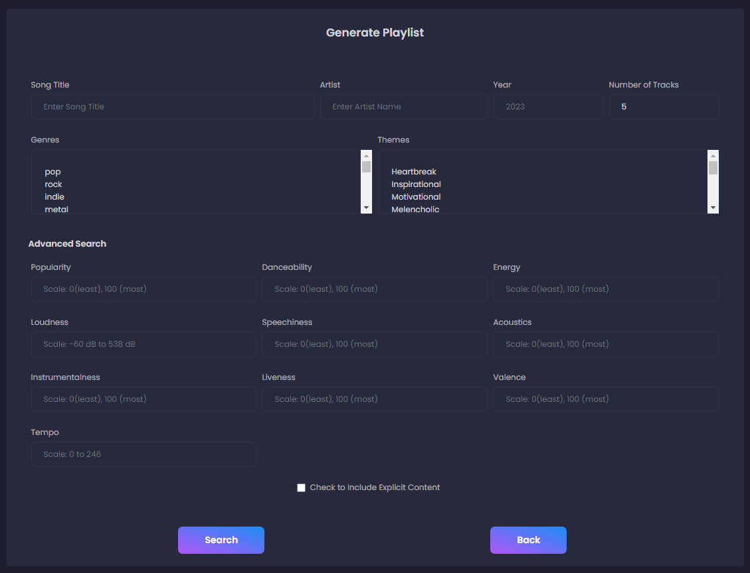
System Overview
Key features and functionality (Search):
Search page that allows users to find music by Song Title, Artist, Genre, Year or Theme (or a combination) with the number of suggestions needed.
10 extra advanced parameters for fine tuning search results –Popularity, Danceability, Energy, Loudness, Speechiness, Acousicness, Instrumentalness, Liveness, Valence, Tempo.
Excludes explicit content by default although the user may opt to include it.

Slide 9
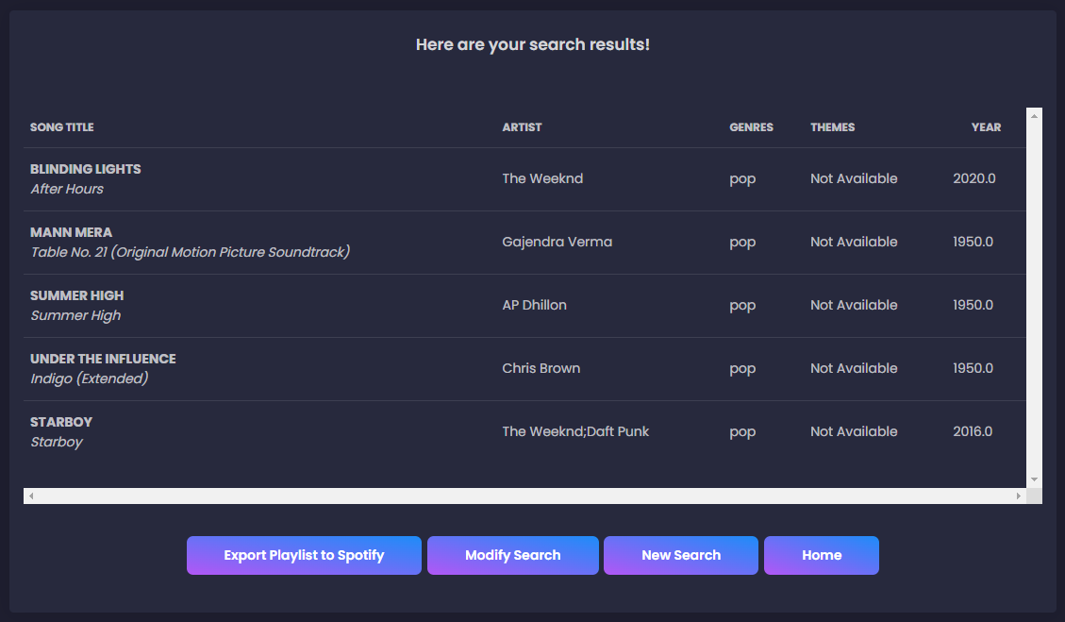
System Overview
Key features and functionality (Results)
Results page displays songs matching user’s query.
Allows user to export playlist to Spotify, Modify the current search or perform a new one.
System's constraints:
Inaccurate/Dissatisfactory results
on some occasions.
No results for highly complex
queries.
Results with no themes.

Slide 10
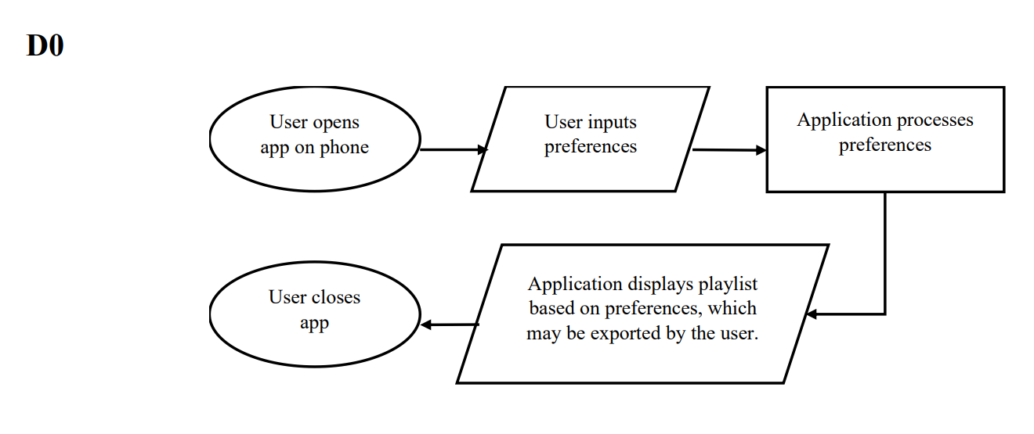
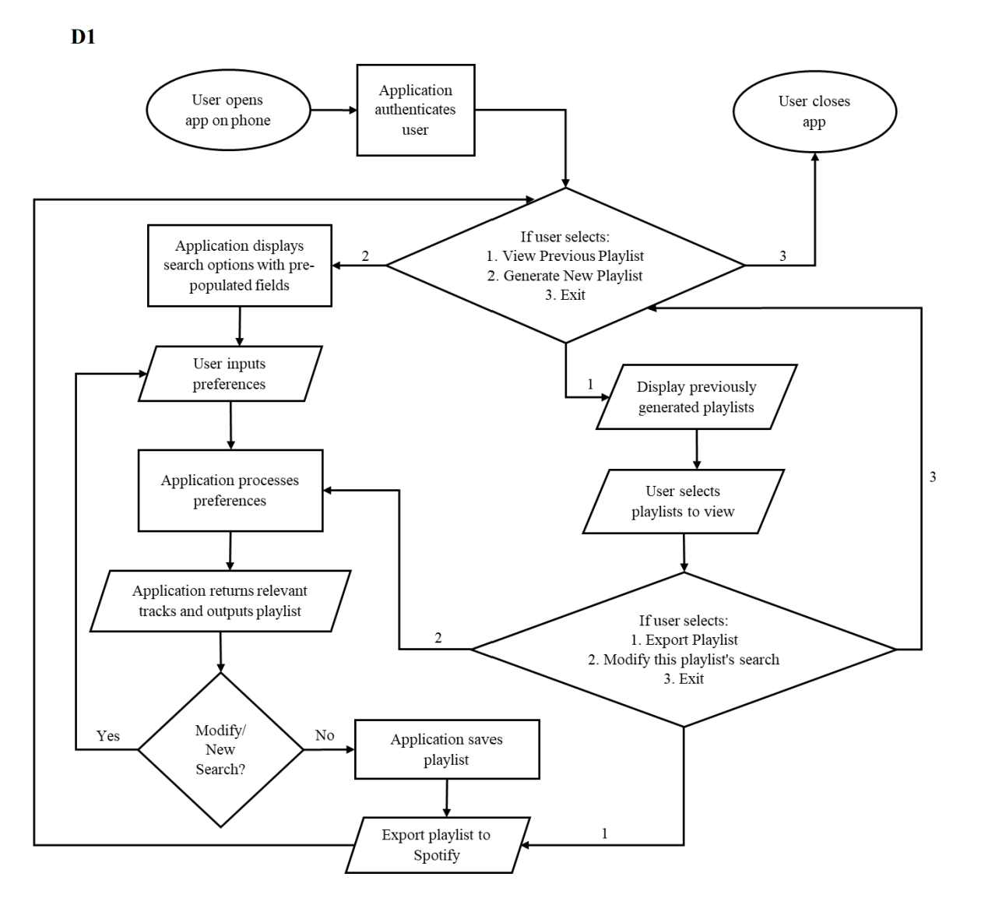
Design Diagrams
Notes:
Now let us look at some of the design diagrams.
D0 is a high-level over-view of the flow of data/control within the application. The over arching idea is that user inputs preferences, which are processed by the application to generate playlist which can then be edited or exported.
D1 is a much more detailed visualization of the program control/data flow. User data is saved by the application, which is accessible once the application authenticates the user (i.e., user exists/creates profile). Once the user is authenticated, depending on the option selected, the user will be either directed to perform their own search or view playlists from previous search. If the user decides to view previously generated playlists, the application will interact with the database to pull the different playlists and display it to the user. From there-on the user can select a playlist – export it to Spotify or modify the search settings used for it and generate a new playlist. The user can also directly generate a new playlist by populating search option fields.

Slide 11
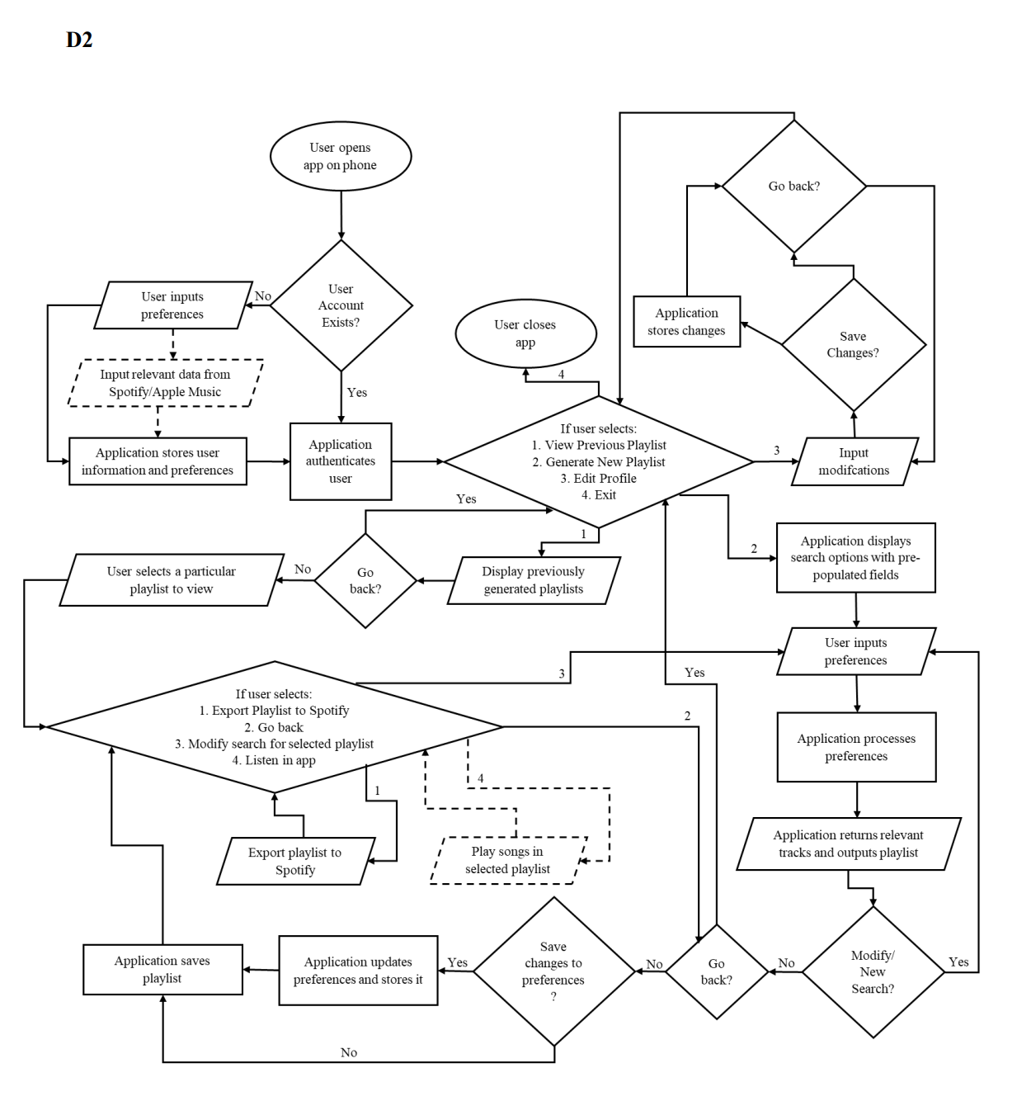
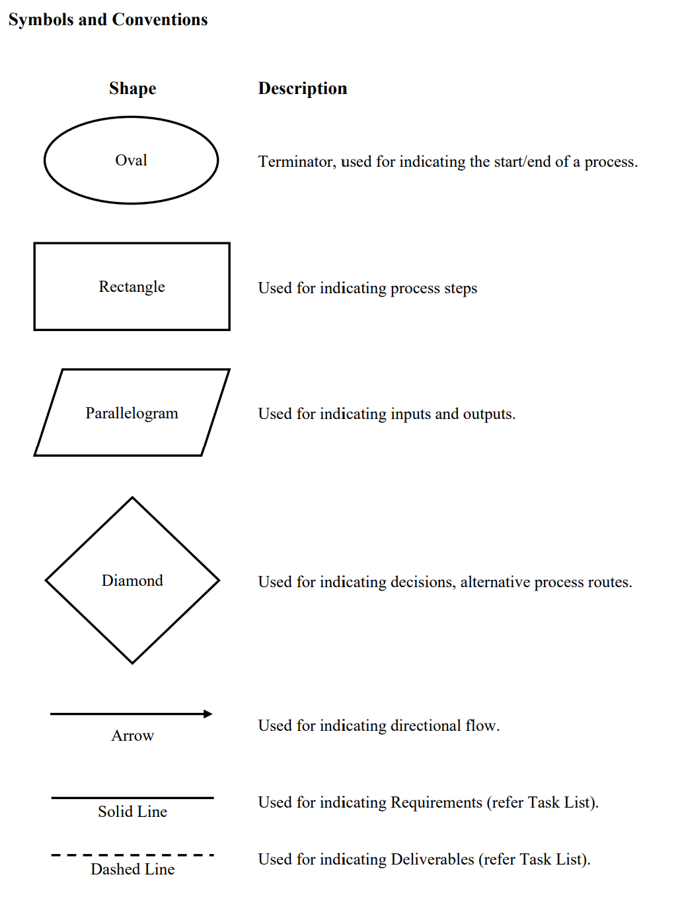
Design Diagrams
Notes:
Finally, D2 is the most detailed expansion of the design diagram. This diagram goes into deeper details on how the data will flow within the application. For example, the creation of a user profile if a user doesn’t exist, user authentication step, the stage at which modifications to search options are stored, etc. It also shows some of the additional features that may be developed and where they fit in the flow of control within the application.

Slide 12
Technologies
Programming Languages – Python, HTML/CSS/JavaScript, SQLite
Frameworks and APIs – Flask, NumPy, Pandas, Matplotlib, scikit-learn, Bootstrap 4, jQuery

Slide 13
Milestones
Total Days
248
Total Hours
281
Phase | Days to complete | Hours of Effort
Preliminary Research | 100 | 44
Prototyping and Designing | 21 | 25
Development | 34 | 62
Testing and Verification | 10 | 23
Refining and Debugging | 12 | 24
Validation and Deployment | 20 | 20
Develop Support For Additional Features | 19 | 38

Slide 14
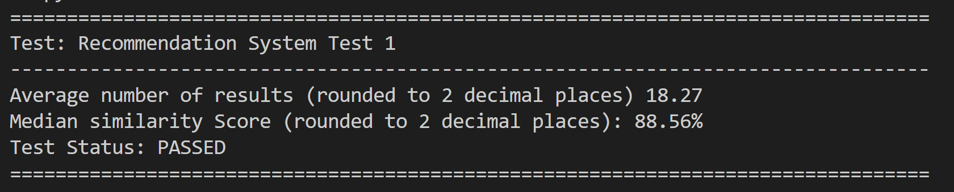
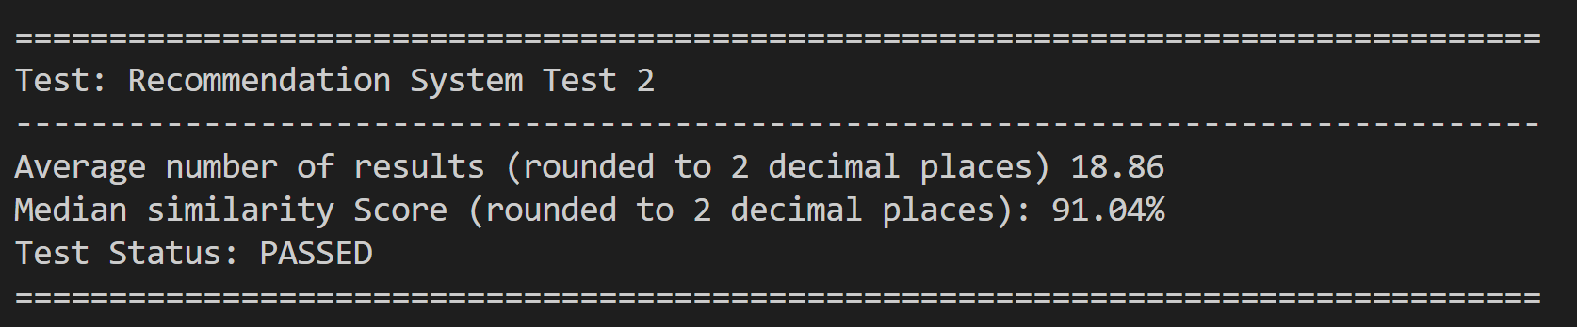
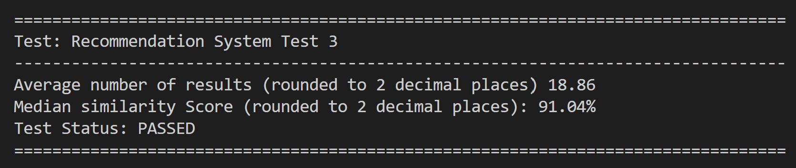
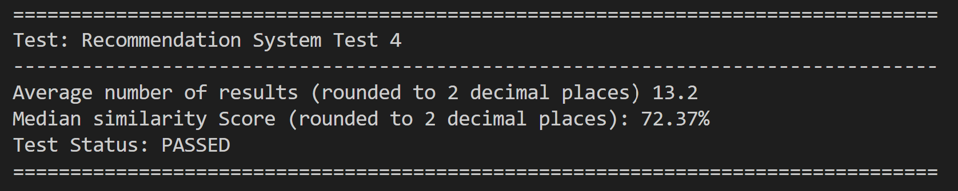
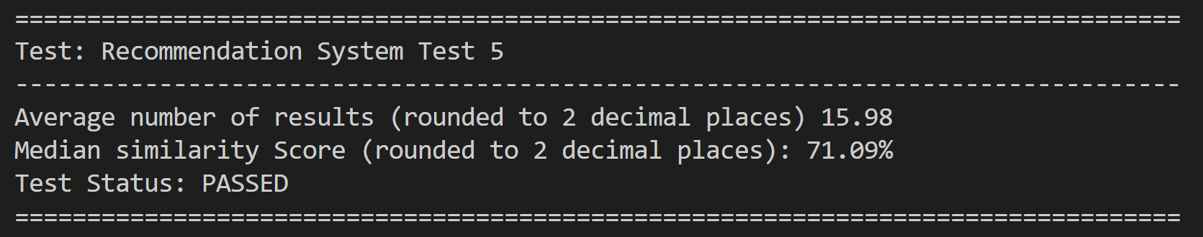
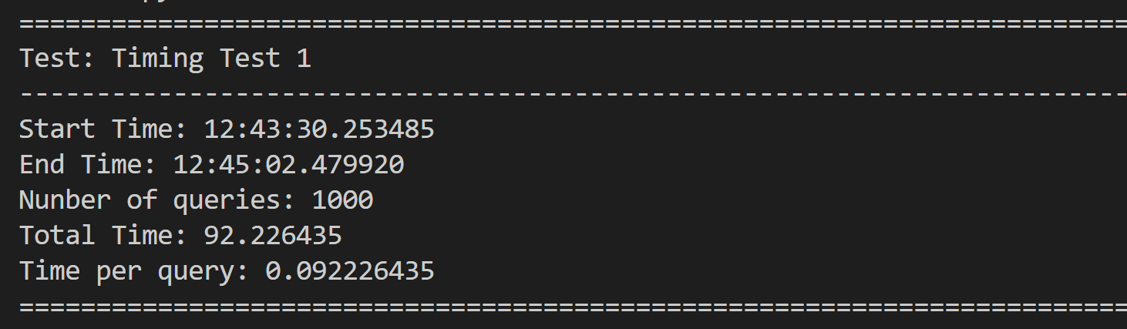

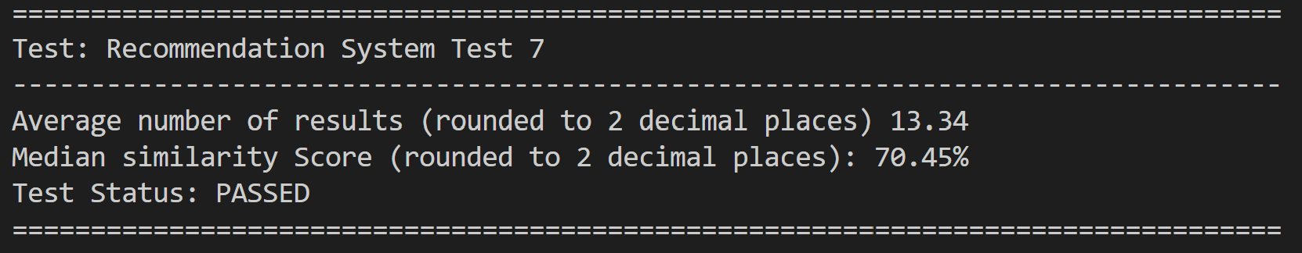
Results
Successful implementation of a Flask application.
Effectively find music based on a variety of parameters, including artist, year, and song title.
At least 10 songs/query on average.
70 % median accuracy.
0.092 seconds/query.

Slide 15

Challenges
Data Cleaning – Several datasets were sourced from Kaggle, a popular data science platform. While these datasets provided valuable information for the project, they also presented some challenges, particularly with regard to data cleaning.
Technical Knowledge and Time - One of the challenges encountered during the TuneMe project was the learning curve and time constraint associated with developing both a frontend and backend application. Initially, the decision was made to separate the frontend using the Ionic framework as an opportunity to learn Android development, while the backend was built using Flask. However, this approach proved to be complicated and time-consuming, leading to the decision to switch to a lightweight Flask application. A cross-disciplinary challenge encountered during the development of the TuneMe application was the need to learn musical terms and concepts in order to effectively categorize and recommend music to users.
Diversity and Cultural Challenges- Music is heavily influenced and differs by cultural attributes, such as language, and instrumentation. Many musical genres are unique to some geographical region or to an ethnic, religious, or linguistic group. Given the extensive nature of music, its it is not feasible to create a solution that is exhaustive and applicable to all kinds of music.

Slide 16
Thank you

